Slide 1

Movie Theater Ticket Sales System
ICS 370 – Software Design models, Ismail Bile Hassan
Sala Chang, Samir Mahamed, Sam Schug

Slide 2


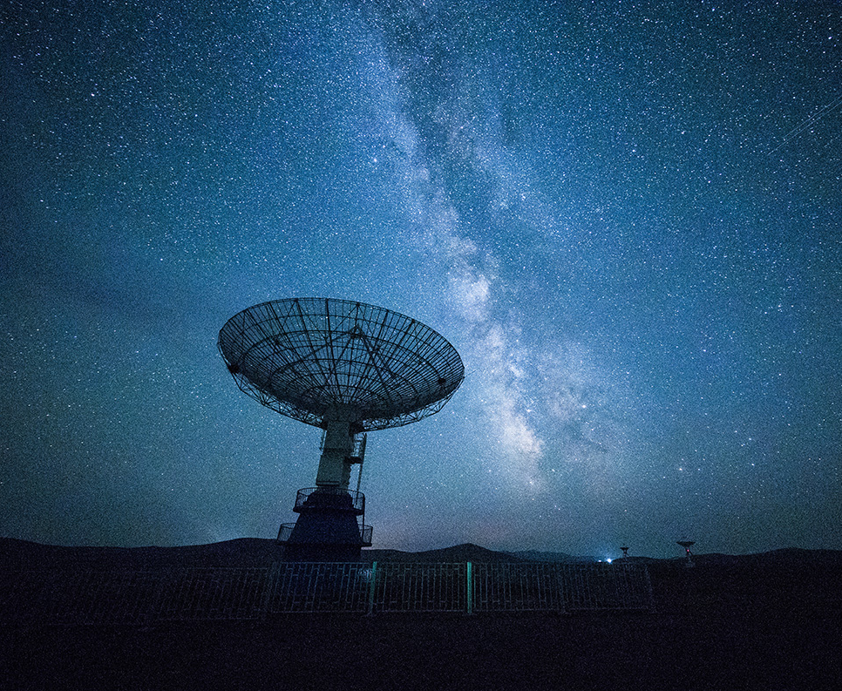
Table of contents
Introduction
Vision and Scope
Business Value
Feasibility Studies
Software Development Methodology
Proposed System Functionalities
Initial Use Case Diagram of the system
Hardware and Software Requirements
Notes:
Introduction(overview of the project and description of the problem) (Sala)
Vision and Scope (SAM)
Business Value (samir)
Feasibility Studies (Sala)
Software Development Methodology (SAM)
Proposed System Functionalities (samir)
Initial Use Case Diagram of your system (Sala)
Hardware and Software Requirements (samir)

Slide 3
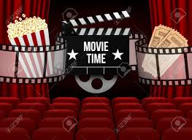
What's the Problem anyway?
Management wants a tool to better understand their sales and be able to compare revenue.
Needs a better system that gathers data from movies in one place (Ticket prices, ticket sales, and date of sales over a specific length of time.)
A tool that can generates analytic records to help for reporting and presenting purposes. (Internal system)
End goal - Tool to help movie theater reach revenue goals.

Slide 4
Movie theatre ticket Sales System: Intro
Few features include:
Management (actors) system used only by management of theater employees. Not for customers.
Can view ticket sales per (length of time) day, week, year, and current running total of sales.
Can view amount of tickets sold per different movie.
Can compare movie/genre sales with other movies.
Only specific to movie theater ticket sales, not including concession or other entertainment sales.
Movie ticketing system is created to help movie theater management better understand their ticket sales and movie entertainment performance records.
This is important because by being able to view the amount of tickets sold per movie/ genre and over a given length of time, management can analyze specific data for understanding sales to improve sales in the future.

Slide 5
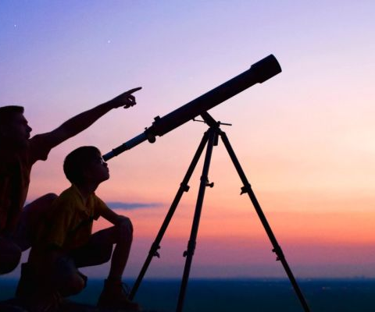

Vision
The purpose of this project is to provide a tool that will allow analytics of ticket sales for a small theatre to aid management in decision making regarding:
Staffing
Marketing
Promotions
Pricing

Slide 6

IN scope:
Intended Audience
Movie Theatre
Small (Five screens or less)
Management Only
Intended Use
Data Analytics On Ticket Sales:
Timeframe
Year, Season, Month, Day, Week, Promotional Period
Genre
Comedy, Horror, Romance, Documentary, Action, Science Fiction, Super Hero

Slide 7

Out of Scope
Audiences
Other Businesses
Movie Theatre
Customers
Entry Level Employees
Large Theatres
Other Uses
Concession Sales
Ticket sales data from other theatres

Slide 8

Business value
Provide better understanding of movie popularity
Plan which movies will need more screen time
Adjust staffing levels based on movie popularity levels
Plans for future promotions and marketing decisions

Slide 9

Business value
The compiled information will give management a sense of understanding within the market trends and have an ability to make predictions based on the information.

Slide 10
Feasibility studies - Will this work?
Technical Feasibility – Can we build this system ?
Application development risks – Low, web page languages: HTML, CSS, JavaScript, PHP, MySQL
Project size – Small project
Compatibility risk – Low , a separate webpage. Not relying on any other major applications-- only uses movie theater inventory database information.
Economic feasibility – Should we build this system?
ROI – 4 year proposal
Benefits of end results – better reporting tool for movie theaters

Slide 11
Feasibilities continue...
Organizational feasibility – Will management actually use this?
Management – Reporting tools, analyzing. Includes: Directors, Finance departments, Technology team, Marketing team, Operating managers.
Practical system tool that can help Cinema organizations gain data about quality of their inventory and develop strategies and processes to increase revenue.
Schedule Feasibility – Time line estimations:
2 months – Planning and designing phase
3 months – Developing and Coding
2 month – Reviewing and testing
2 month – Continuous developing and testing
1 month – First product deployment
Continuous maintenance..

Slide 12
Software Development Methodology
Agile – Why we are using it:
Iterative life cycle allows for more user involvement
Desired Outcomes:
User friendly system
Tool provides reports that have practical business use to the intended user

Slide 13

Proposed system functionalities
Ability to view individual stats for a movie
Ability to compare different movies against each other
Real time data updates
Quick and easy to use UI

Slide 14
Proposed system functionalities
Keep backups saved on the cloud
Editing information in tables for new movies
Easy to read and understand information

Slide 15
Use Cases - temp mock up
Who uses the system / Stakeholders?
Who loads/edits/manages the system ?
Management Team - Login
Select From 4 options:
1] View current Stats of all movies
2] Select a genre
- Select a movie
3] Select to compare
-Select genre
-Select movie
-Select length of time
View display records
-Create PDF or Print or Export
4] Sign Out
System / Administrator Manager - Login
1] Select and Load Movie Inventory
2] Verify Correct Inventory data values
3] Save
4] Sign out

Slide 16
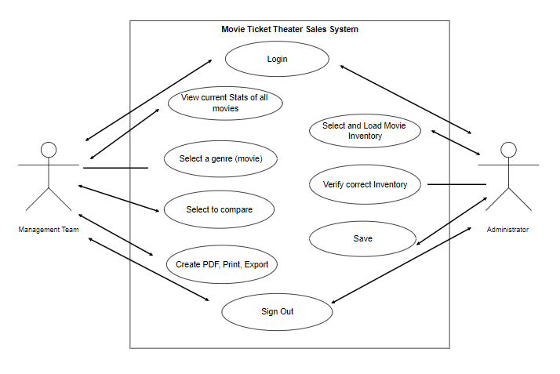
Use Case/ Activity Diagram Management Team:
Management actors and their capable functions of the system.
Management – Includes: Directors, Finance departments, Technology team, Marketing team, Operating managers.
Are given 3 different options to choose from and stats / data can be viewed.

Slide 17
USE CASE/ ACTIVITY DIAGRAM Systems Administrator:
Systems administrator actors and their capable functions of the system.
Is given 1 main function to add the data of Movie Inventory and verify if data values are displaying correctly.

Slide 18

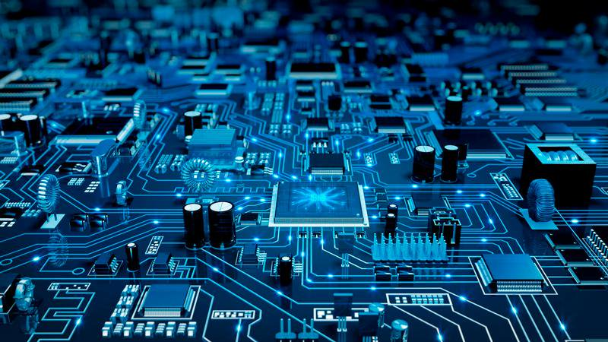
Hardware Requirements
Hardware that is reasonable enough to store a large amount of information.
A Reliable Internet connection.
A computer or server to access the information

Slide 19
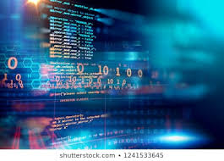
Software requirements
Web based application utilizing:
HTML
CSS
JavaScript
MySQL
Java GUI
Accessible via URL for authorized users

Slide 20

Thank You!

